Slide 1
Chapter 5 Digital Building Blocks (2) - Number Systems
Suffolk County Community College
CSE 222, Spring 2020

Slide 2
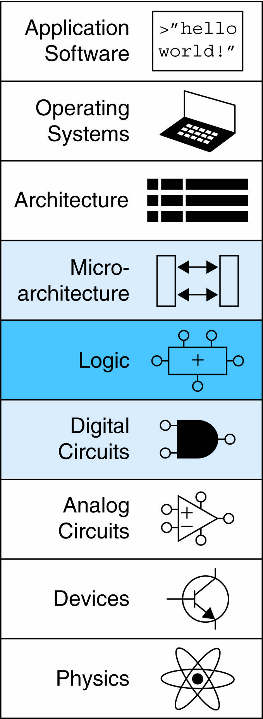
Topics:
Introduction
Arithmetic Circuits
Number Systems
Sequential Building Blocks
Memory Arrays
Logic Arrays

Slide 3
Number Systems
Numbers we can represent using binary representations
Positive numbers
Unsigned binary
Negative numbers
Two’s complement
Sign/magnitude numbers
Fractions
Two common notations:
Fixed-point: binary point fixed
Floating-point: binary point floats to the right of the most significant 1

Slide 4
Number Systems
Fixed-Point Numbers
6.75 using 4 integer bits and 4 fraction bits:
Binary point is implied
The number of integer and fraction bits must be agreed upon beforehand
Example:
Represent 7.5₁₀ using 4 integer bits and 4 fraction bits ?
Notes:
0111 1000

Slide 5
Number Systems
Signed Fixed-Point Numbers
Representations:
Sign/magnitude
Two’s complement
Example: Represent -7.5₁₀ using 4 integer and 4 fraction bits
Sign/magnitude:
Two’s complement:
Notes:
0111 1000

Slide 6
Number Systems
Signed Fixed-Point numbers
Representations:
Sign/magnitude
Two’s complement
Example: Represent -7.5₁₀ using 4 integer and 4 fraction bits
Sign/magnitude:
11111000
Two’s complement:
1. +7.5: 01111000
2. Invert bits: 10000111
3. Add 1 to lsb: + 1
10001000
Notes:
0111 1000

Slide 7
Number Systems
Floating-Point Numbers
Binary point floats to the right of the most significant 1
Similar to decimal scientific notation
Example, write 273₁₀ in scientific notation:
273 = 2.73 × 10²
In general, a number is written in scientific notation as:
± M × B^{E}
M = mantissa
B = base
E = exponent
In the example, M = 2.73, B = 10, and E = 2
Notes:
0111 1000

Slide 8
Number Systems
Floating-Point Numbers
Example: represent the value 228₁₀ using a 32-bit floating point representation
Notes:
three versions

Slide 9
Number Systems
Floating-Point Numbers: Representation 1:
Convert decimal to binary:
228₁₀ = 11100100₂
Write the number in “binary scientific notation”:
11100100₂ = 1.11001₂ × 2⁷
Fill in each field of the 32-bit floating point number:
The sign bit is positive (0)
The 8 exponent bits represent the value 7
The remaining 23 bits are the mantissa
Notes:
three versions
(don’t reverse steps 1 & 2!):

Slide 10
Number Systems
Floating-Point Numbers: Representation 2:
First bit of the mantissa is always 1:
228₁₀ = 11100100₂ = 1.11001 × 2⁷
No need to store it: implicit leading 1
Store just fraction bits in 23-bit field
Notes:
three versions

Slide 11
Number Systems
Floating-Point Numbers: Representation 3:
Biased exponent: bias = 127 (01111111₂)
Biased exponent = bias + exponent
Exponent of 7 is stored as:
127 + 7 = 134 = 0x10000110₂
The IEEE 754 32-bit floating-point representation of 228₁₀
in hexadecimal: 0x43640000
Notes:
three versions

Slide 12
Number Systems
Floating-Point Examples
Write -58.25₁₀ in floating point (IEEE 754)
Convert decimal to binary:
58.25₁₀ = 111010.01₂
Write in binary scientific notation:
1.1101001 × 2⁵
Fill in fields:
Sign bit: 1 (negative)
8 exponent bits: (127 + 5) = 132 = 10000100₂
23 fraction bits: 110 1001 0000 0000 0000 0000
in hexadecimal: 0xC2690000
Notes:
three versions

Slide 13
Number Systems
Floating-Point: Special Cases
Number | Sign | Exponent | Fraction
0 | X | 00000000 | 00000000000000000000000
∞ | 0 | 11111111 | 00000000000000000000000
- ∞ | 1 | 11111111 | 00000000000000000000000
NaN | X | 11111111 | non-zero
Notes:
three versions

Slide 14
Number Systems
Floating-Point: Precisions
Single-Precision:
32-bit
1 sign bit, 8 exponent bits, 23 fraction bits
bias = 127
Double-Precision:
64-bit
1 sign bit, 11 exponent bits, 52 fraction bits
bias = 1023
Notes:
three versions

Slide 15
Number Systems
Floating-Point: Rounding
Overflow: number too large to be represented
Underflow: number too small to be represented
Rounding modes:
Down
Up
Toward zero
To nearest
Example: round 1.100101 (1.578125) to only 3 fraction bits
Down: 1.100
Up: 1.101
Toward zero: 1.100
To nearest: 1.101 (1.625 is closer to 1.578125 than 1.5 is)
Notes:
three versions

Slide 16
Number Systems
Floating-Point: Addition
Extract exponent and fraction bits
Prepend leading 1 to form mantissa
Compare exponents
Shift smaller mantissa if necessary
Add mantissas
Normalize mantissa and adjust exponent if necessary
Round result
Assemble exponent and fraction back into floating-point format
Notes:
three versions

Slide 17
Number Systems
Floating-Point: Addition
Example: Add the following floating-point numbers:
0x3FC00000
0x40500000
Notes:
three versions

Slide 18
Number Systems
Floating-Point: Addition
1. Extract exponent and fraction bits
For first number (N1): S = 0, E = 127, F = .1
For second number (N2): S = 0, E = 128, F = .101
2. Prepend leading 1 to form mantissa
N1: 1.1
N2: 1.101
Notes:
three versions

Slide 19
Number Systems
Floating-Point: Addition
3. Compare exponents
127 – 128 = -1, so shift N1 right by 1 bit
4. Shift smaller mantissa if necessary
shift N1’s mantissa: 1.1 >> 1 = 0.11 (× 2¹)
5. Add mantissas
0.11 × 2¹
+ 1.101 × 2¹
10.011 × 2¹
Notes:
three versions

Slide 20
Number Systems
Floating-Point: Addition
6. Normalize mantissa and adjust exponent if necessary
10.011 × 2¹ = 1.0011 × 2²
7. Round result
No need (fits in 23 bits)
8. Assemble exponent and fraction back into floating-point format
S = 0, E = 2 + 127 = 129 = 10000001₂, F = 001100..
in hexadecimal: 0x40980000
Notes:
three versions

